Slide 1

Pokégans
Generating new Pokémon with generative adversarial networks
Nicolai Hermann,
Michael Hüppe

Slide 2
Table of contents
Data
webscraping
uniforming
Inspiration
Model
Vanilla GAN
Problems
Solution
WGAN-GP
AEGAN
Training
Implementation
Results
DCGAN
WGAN-GP
AEGAN
Comparison
Outlook
References

Slide 3



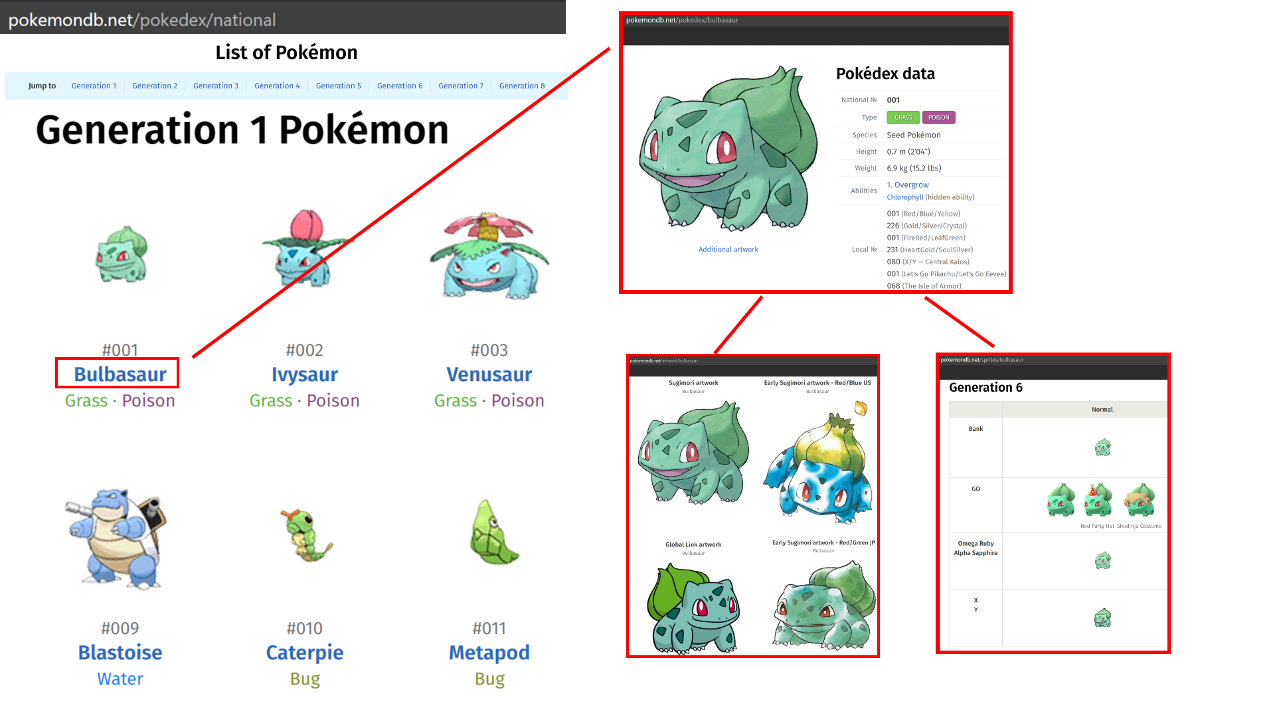
Webscraping data
Packages used: os,request,bs4
Request the parsed html (soup)
get the link for every pokemon entry
access the list of image data by changing the identifier (artwork or sprites)
get download link of each individual image
download and uniform it

Slide 4
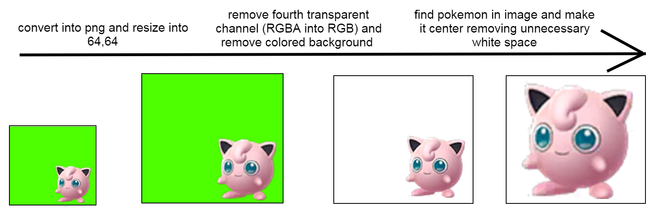
Uniforming data
Packages used: PIL,cv2, numpy
Goal: uniform all images so they are the same shape, file type, image mode, have the same background and have no unnecessary white space

Slide 5
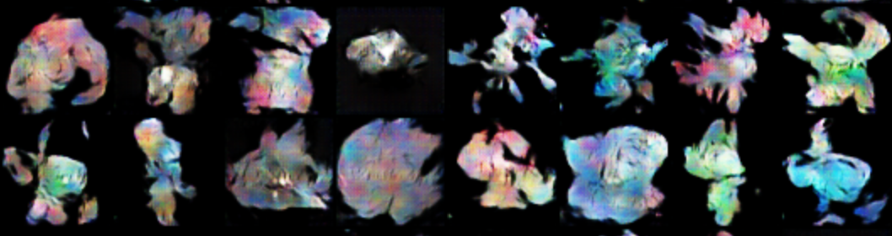
Inspiration
Most of the already implemented versions we found hat either a really small data set (900) or only a simple vanilla GAN
Results often show artifacts or checkerborad phenomeneon and no visible resemblence

Slide 6
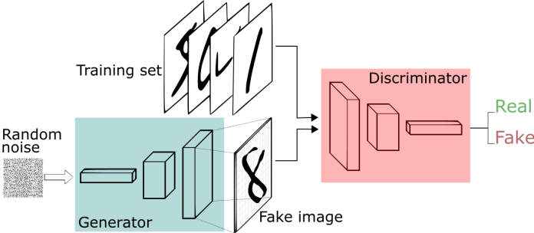
GAN
The basic generative adversarial network consists of the Generator and the Discriminator
The Discrminator returns a probability wheter the given image was fake of real (being fed both of them during training)
The Generator uses noise and returns generated images trying to look as real as possible
The generator tries to fool the discriminator while its trying to distinguish between real and generated images
The discriminator uses Binary classification loss while the Generators weights are updated with the negative loss of the discriminator

Slide 7
Problems
No convergence rather Nash equilibrium (which is hard to achieve)
Discriminator directly influences the Generator
If the discriminator is classifies over-proportionally good its loss gets closer to zero resulting in vanishing gradients and no or slow learning for the generator
How a bad performance leaves the generator with no meaningful representation to replicate
Mode collaps (the Generator focuses on a small latent space and replicates images with no variation)
No good evaluation metric

Slide 8
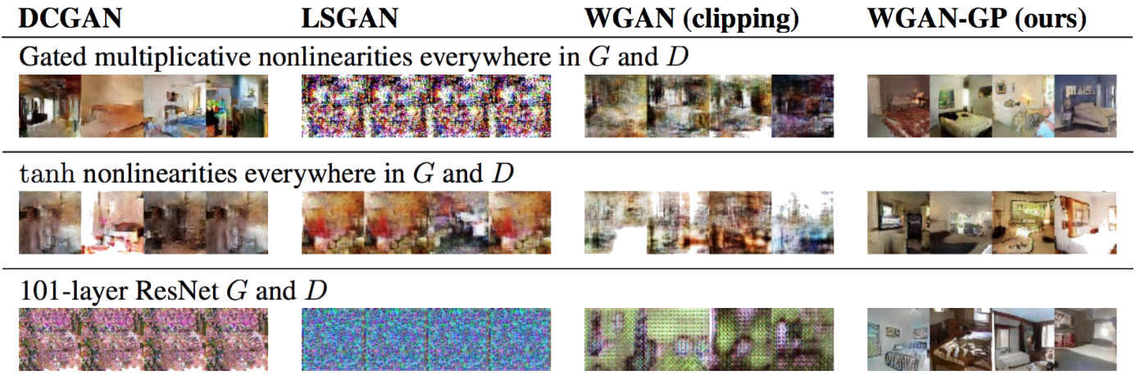
WGAN-GP
employs “Wasserstein distance” or “Earth-Movers Distance”
Cost function defining the minimum distance it takes to convert one probability distribution into another one
Lipshitz continuity has to be used
Smooth weight updating
Normally done by applying weight clipping
If the clipping window is not appropriate it can still cause vanishing/exploding gradients
Gradient penalty used instead
The discriminator is fed 50% real and generated images therefore the gradient norm should be 1
The generator is penalized for different gradient norm
Gives a more valuable evaluation metric (the loss of the generator can be a representative of the quality of the images

Slide 9
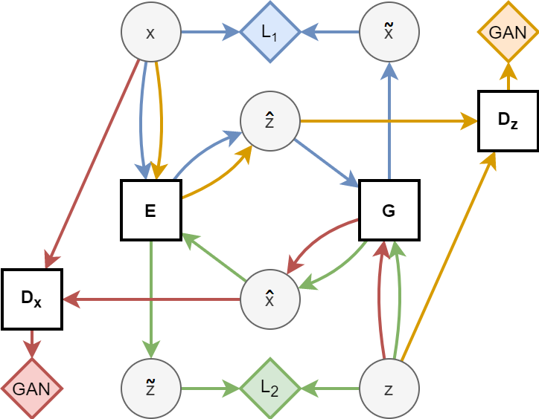
AEGAN
Employs bijective mapping (from sample space to latent space and vice versa)
Generator tries to replicate real samples from latent points
Encoder generates latent points from real samples
Use two seperate discriminators
one for differentiating between real/generated samples and one for distinguishing between real/generated latent points
Combines four networks

Slide 10
Training
Employs bijective mapping (from sample space to latent space and vice versa)
Generator tries to replicate real samples from latent points
Encoder generates latent points from real samples
Use two seperate discriminators
one for differentiating between real/generated samples and one for distinguishing between real/generated latent points
Combines four networks

Slide 11
Training
WGAN_GP
AEGAN
Train the generator and the discriminator and get both of their losses
Train the discriminator 5 times as much as the generator
Take the norm of the gradient and calculate the gradient penalty
Multiply this penalty with a constant weight factor and add it to the loss of the discriminator loss
Finally update the weights of the network given its optimizer
Hyperparameters:
Batch size: 32
Optimizer: ADAM
Loss: Wasserstein distance
Learning rate: 0.0002
1 training step: 8 updates ( 2 x 8 = 16 in total)
Discriminator is trained on two real data batches
Image discriminator -> additional batch of reconstructed and generated images
Latent discriminator -> additional batch of reconstructed latent vectors and one of embedded real images
Hyperparameters:
Batch size: 32
Latent space: 72
Loss: binary Cross entropy
Learning rate: 0.0005

Slide 12
Implementation WGAN-GP
Used: tf, keras
Modified official keras implementation
Define generator and discriminator as functions
WGAN class combine both models and override train_function and employ gradient penalty
GANmonitor class: create callball function and define what to do after an epoch (save model and images)
Define Wasserstein for both models
Compile both models with ADAM optimizer and Wasserstein loss

Slide 13
Implementation AEGAN_
Used: tf, keras
The AEGAN paper offered a code, constructed for the ’anime faces’dataset
only keeping the rough architecture of the model
relying more on sub-class models was a big mistake as saving them, while using custom layers, is almost impossible.
switch back to functional models
Overwrite trainstep function to use ”.fit” and ”.compile”

Slide 14
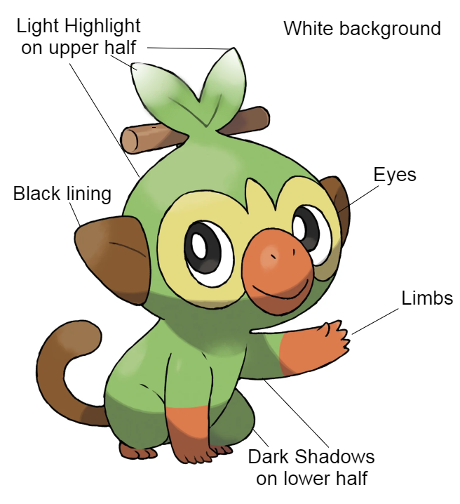
Results criteria
After training and browsing dataset following criteria were found to determine the qualtiy of the generated images

Slide 15
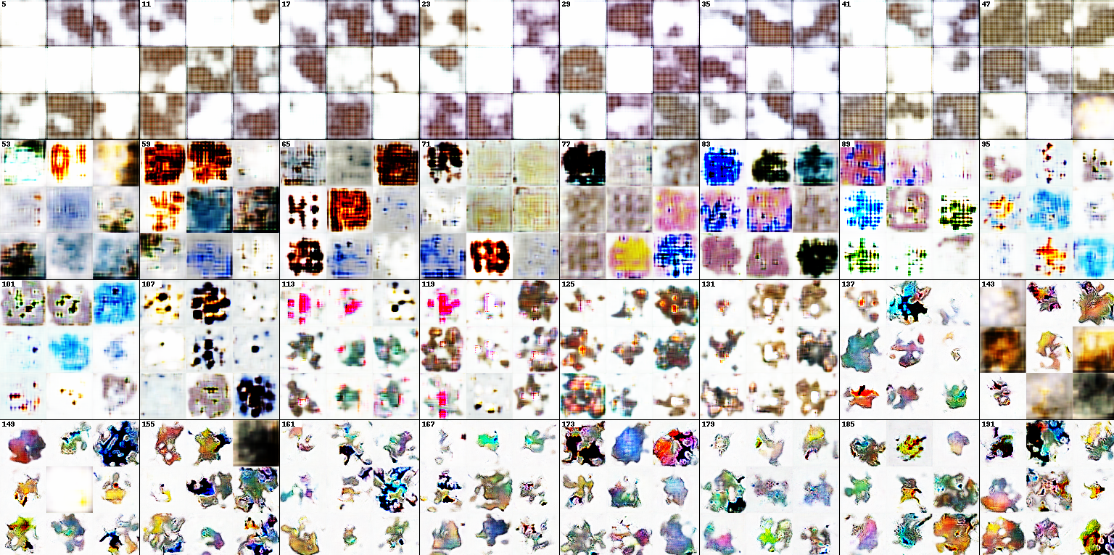
Results DCGAN
Animated progress
0-50: make center focus and create white background
50-100: uses more color
100-150: remove artifacts
150: hints ofblack lining
150- 900: no further improvements

Slide 16
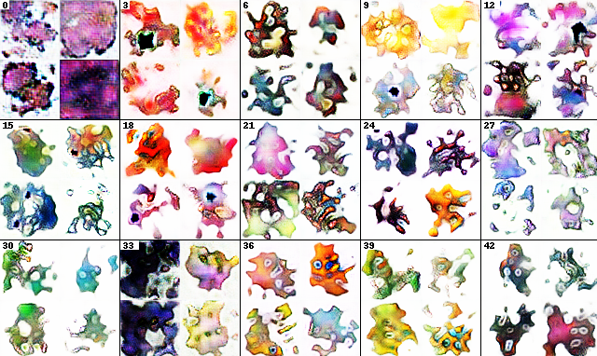
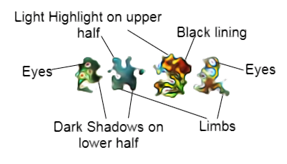
Results WGAN-GP
Animated progress
0-3: make white background
3-12: black lining
12-27: shadows and highlights
27-42: eyes (small hints at limbs but no clear body shape)

Slide 17
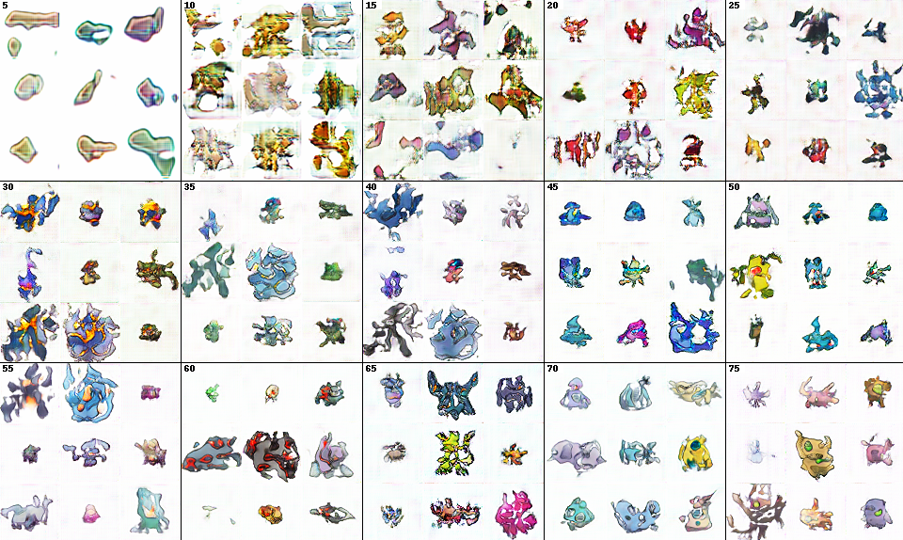
Results AEGAN
0-5: white background and darker lining
5-30: shading
30-50: body shapes and distinct limbs
70+ eyes

Slide 18
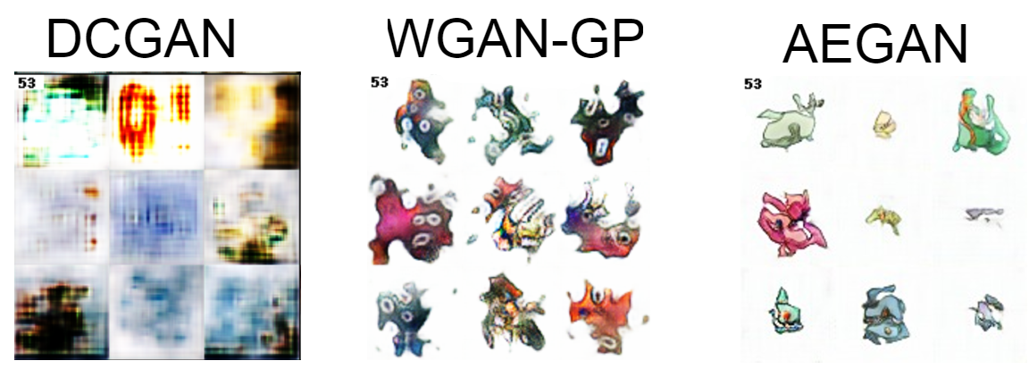
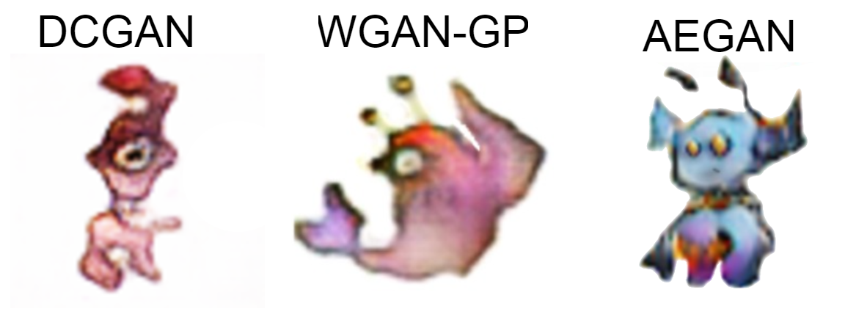
Results in comparison
Both WGAN-GP and AEGAN gave more training stability and better results with fewer training
While WGAN-GP‘s results have prominent eyes AEGAN had a more distinct body shapes

Slide 19
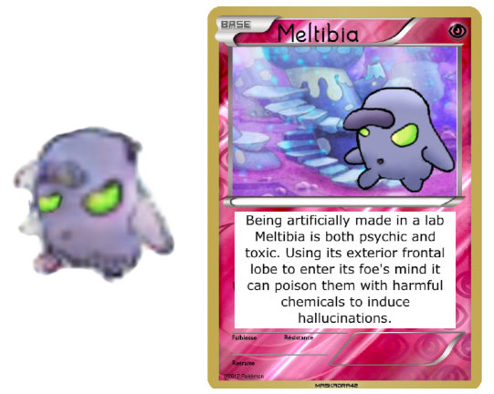
Outlook
Combining AEGAN and WGAN-GP
Color coding
Class conditional grouped by body shape
Classifier to attribute generated pokemon with name, type, move-sets
Intended use: inspiration for new designs to help artists

Slide 20
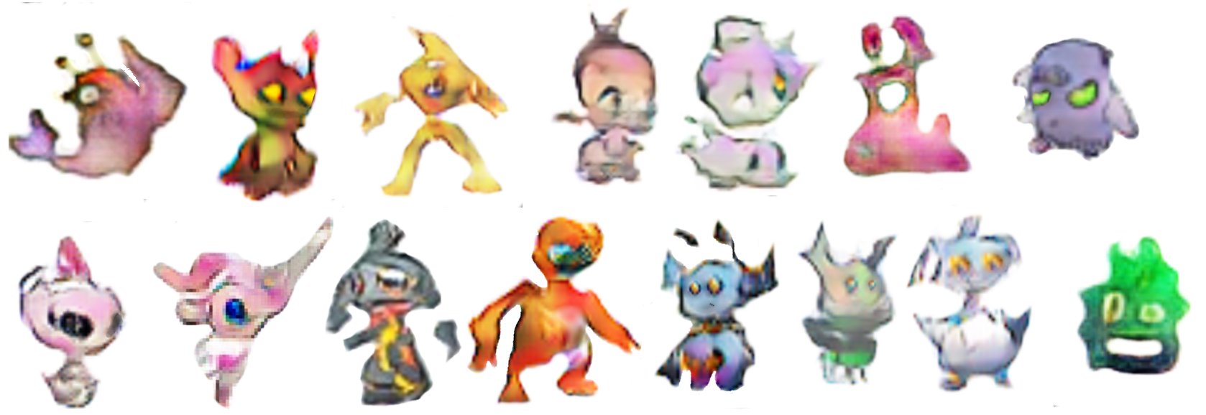
Proudest achievements
Webscraping and uniforming for data resulting in the biggest image dataset we could find
Implementing a newer and complex structure from a paper and using it to improve results (AEGAN)

Slide 21
References
Franc ̧ois Chollet. Dcgan-gp overriding model.trainste p.2020
Ishaan Gulrajani, Faruk Ahmed, Martin Arjovsky, Vincent Dumoulin, and Aaron C Courville.Improved training of wasserstein gans. 30, 2017.
Conor Lazarou. Autoencoding generative adversarial networks. 2020.
Conor Lazarou. I generated thousands of new pokemon using ai. 2020.
Aakash Kumar Nain. Wgan-gp overriding model.trainste p.2020.

